Slide 1
understanding teaching at Loyola university Chicago presentation for new faculty orientation

Slide 3
Land Acknowledgement
The Loyola community occupies the ancestral homelands of the people of the Council of Three Fires, an alliance which formed based on the shared language, similar culture, and common historical background of its three historical members: the Odawa, Potawatomi, and Ojibwe nations.
The land that Loyola occupies, which includes the shore and waters of Lake Michigan, was also a site of trade, travel, gathering and healing for more than a dozen other Native tribes, including the Menominee, Michigamea, Miami, Kickapoo, Peoria and Ho-Chunk nations. The history of the city of Chicago is intertwined with histories of native peoples. The name Chicago is adopted from the Algonquin language, and the Chicagoland area is still home to the largest number of Native Americans in the Midwest, over 65,000. The history of the lands Loyola occupies, and the history of Native Americans in Chicago and Illinois, is a history of displacement, conquest, and dehumanization.
We at Loyola, in step with our Jesuit Catholic tradition, must commit to acknowledging this violent history by incorporating Native American texts and perspectives into our classes and working to keep this shared history alive in our study, conversation, and professional development.

Slide 4
Today's Session Agenda
Agenda
Share our approach to professional development and our year-long plan
Review the goals of today’s session
Interactive workshop: activities, information sharing, dialogue

Slide 5
Stretching

Slide 6
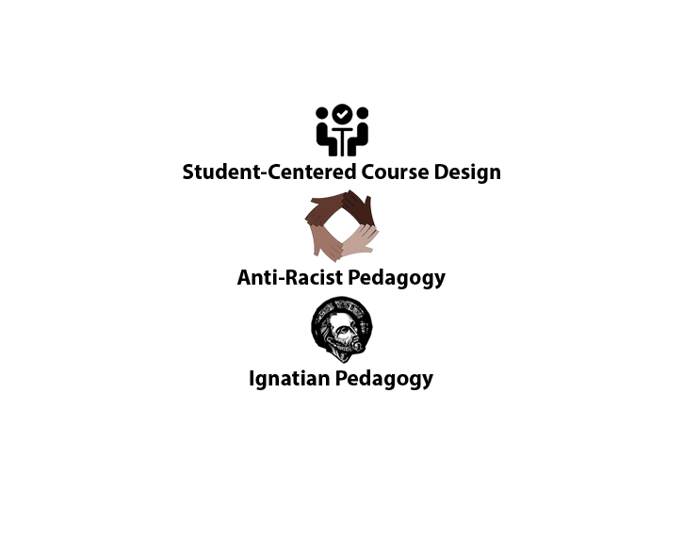
Approach to Teaching at LUC
ARP
Notes:
Jessica
One of the things that happened over the past two years, and even more so in the last 12 months, we recognized that our work was flowing out of and representative of three distinct pedagogical approaches: of course, IP, and also Universal Design for Learning and Anti-racist pedagogy. UDL is an approach to course design and facilitation that centers engagement, access and flexibility. These tenants of UDL make it a perfect match/conversant with IP and ARP.
We share these specifics with you to let you in on our vision for the future: Under our co-leadership, FCIP will move forward with our work in these three areas, and allowing us to create a new pedagogical approach at the nexus of them.
to share and foster Ignatian, student-centered, socially-just pedagogical practices that are responsive and nimble throughout Loyola and beyond.
This is what allows us to move into the future: this pedagogical vision + our leadership
Honoring dignity and worth of each individual person
Pushing against the status quo, critical theories
Inclusive, accessible, flexible
Bringing in people from the margins
Reflection and integration
Globally minded
epistemic justice
(in our own words: everyone’s perspective matters, learning is liberating

Slide 7
Year-long Orientation Series
https://www.luc.edu/fcip/programs/teachinglearningworkshops/

Slide 8
Today's Session outcomes
Session Outcomes
Recognize the five components of the IPP (context, experience, reflection, action, evaluation)
Give examples of strategies you can use in your teaching and course design that may be especially effective with generation z students
Explain how you can use, or modify, the activities you did today for use with your students
Describe some characteristics of generation z students
Demonstrate awareness of where to continue to get support related to teaching and learning on campus

Slide 9
Ignatian Pedagogical Paradigm

Slide 10
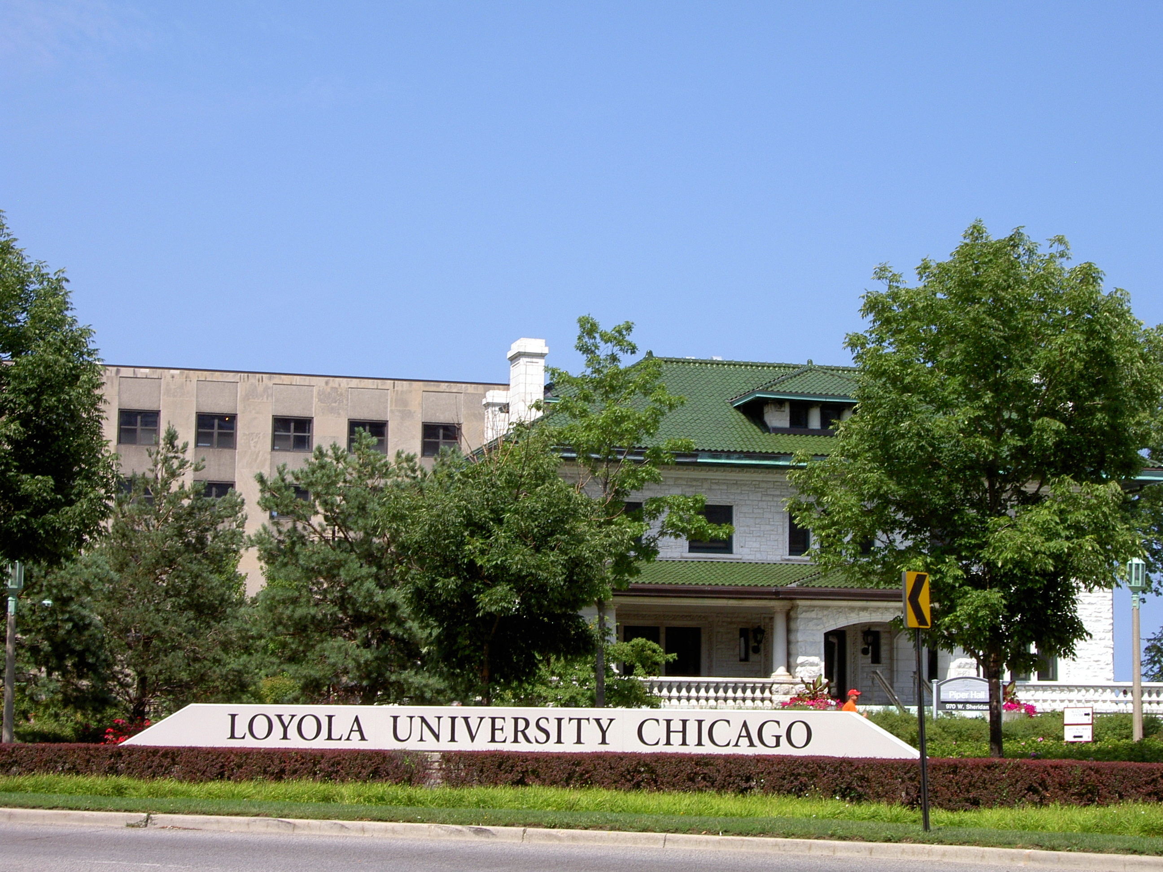
What is Context and why is It important?

Slide 11
Free Write: Context
What needs to be known about students (their environments, backgrounds, communities, etc.) to teach them well?
What do you need to know about yourself as an instructor?
This Photo by Unknown author is licensed under CC BY-SA-NC.

Slide 12
Free write: Share
This Photo by Unknown author is licensed under CC BY-SA-NC.

Slide 13
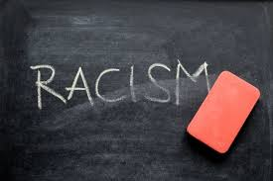
Context

Slide 14
Who are generation Z students?
Born after 1996
Digital natives: Life without smart phones?
Most ethnically diverse
More likely to finish high school and enroll in college than prior generations
Concerned about the future, particularly the environment
https://www.pewresearch.org/social-trends/2020/05/14/on-the-cusp-of-adulthood-and-facing-an-uncertain-future-what-we-know-about-gen-z-so-far-2/

Slide 15
Why care about generation Z students?
NOTE: generational labeling is a generalization and always changing
Each generation has certain values, behaviors, expectations that have implications for communication, work ethic, goals
Particularly essential for new teachers to have a sense of who students are/what they need
Green, D. D., & McCann, J. (2021). The Coronavirus Effect: How to Engage Generation Z for Greater Student Outcomes. Manag Econ Res J, 7(1), 2007.
Mohr, K. A., & Mohr, E. S. (2017). Understanding Generation Z students to promote a contemporary learning environment. Journal on Empowering Teaching Excellence, 1(1), 9.

Slide 16
Values of Gen Z Students
Relationships, regular contact
Autonomy and self-direction
Relevance, practicality
Recognizing diversity
Green, D. D., & McCann, J. (2021). The Coronavirus Effect: How to Engage Generation Z for Greater Student Outcomes. Manag Econ Res J, 7(1), 2007.
Mellman, L., Williams, M. K., & Slykhuis, D. A. (2021). Using Generation Z's Learning Approaches to Create Meaningful Online Learning. In Handbook of Research on Transforming Teachers’ Online Pedagogical Reasoning for Engaging K-12 Students in Virtual Learning (pp. 149-169). IGI Global.

Slide 17
Revisiting Context
Why did we talk about context? What did we learn?

Slide 18
Experience
Past
Current
Future

Slide 19
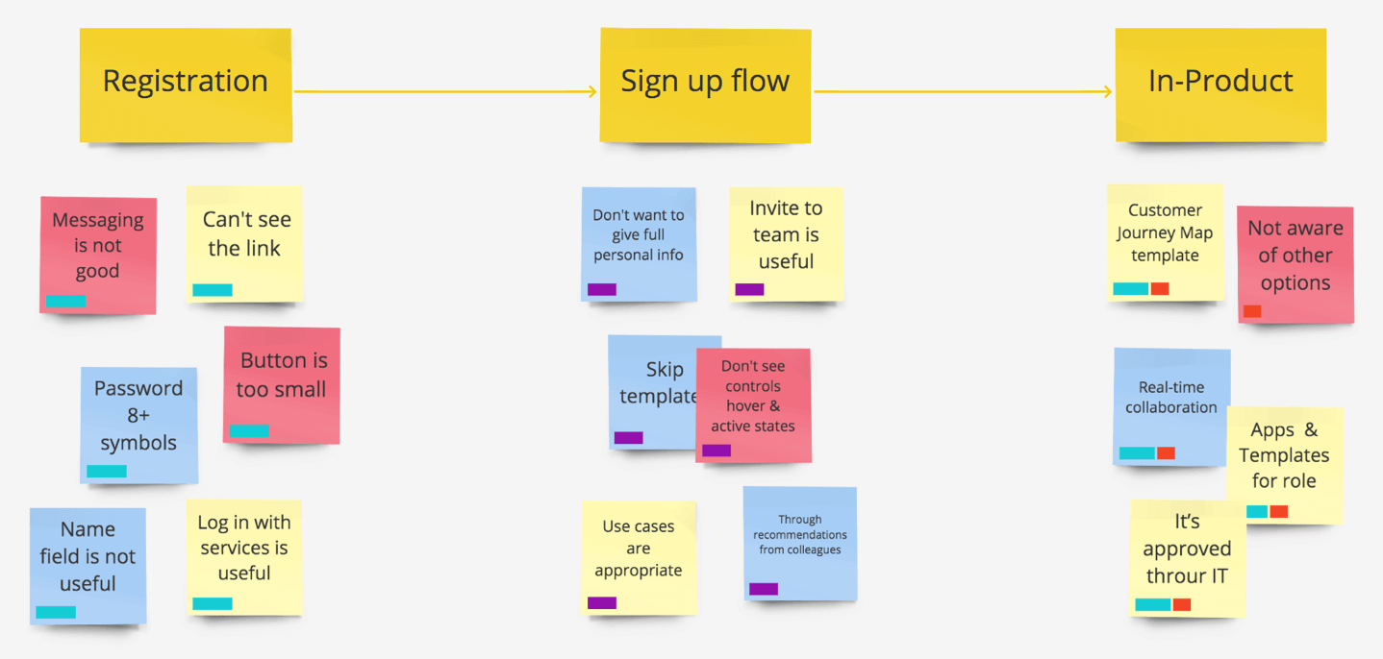
Recognizing and Sharing Your Experiences: Jamboard
What experiences are you and the students bringing into the classroom (some of which we may have just discussed) and how do you feel about them?
Where/how have your previous experiences, values, attitudes and biases shaped your teaching thus far?
What is your experience with learning needs or values of gen z students?
This Photo by Unknown author is licensed under CC BY-SA-NC.
Notes:
Jamboard: https://jamboard.google.com/d/15m3bccyzBjKF0pTTZmCeNBnS6MKy9Zvd1Q4j0K-2Yg0/edit?usp=sharing

Slide 20
What is Reflection and why is it important?

Slide 21
Individual Guided Reflection: Think

Slide 22
Reflection: Share
This Photo by Unknown author is licensed under CC BY-SA-NC.

Slide 23
Stretching

Slide 24
What is Action and why is it important?

Slide 25
Moving from Knowledge to Action
What actions might you take in your classes as a result of what you are learning so far today?
What actions could your students take to help them integrate and deepen their learning from your course?
What assignments or activities could you introduce to promote meaningful action on your course content?
Googledoc Activity
Notes:
Google doc: https://docs.google.com/document/d/1TyVep_oBtHZYkdPwrssri3M7E_5hdq4H4fxpL85n1qw/edit?usp=sharing

Slide 26
What did you hear or read that resonates with you?
This Photo by Unknown author is licensed under CC BY-SA-NC.

Slide 27
Strategies and Practices for Teaching Generation Z
Instructor serves as guide on side
Provide variety of instructional materials and assignment types
Balance autonomy with structure
Provide guidance on how to sift through information overload
Give the why (e.g., you’ll need this in order to....)
Green, D. D., & McCann, J. (2021). The Coronavirus Effect: How to Engage Generation Z for Greater Student Outcomes. Manag Econ Res J, 7(1), 2007.
Mellman, L., Williams, M. K., & Slykhuis, D. A. (2021). Using Generation Z's Learning Approaches to Create Meaningful Online Learning. In Handbook of Research on Transforming Teachers’ Online Pedagogical Reasoning for Engaging K-12 Students in Virtual Learning (pp. 149-169). IGI Global.
Mohr, K. A., & Mohr, E. S. (2017). Understanding Generation Z students to promote a contemporary learning environment. Journal on Empowering Teaching Excellence, 1(1), 9.

Slide 28
Pulling it All Together

Slide 29
What is Evaluation and why is it important?

Slide 30
Complete this anonymous feedback form to share what you learned today!
Notes:
https://forms.gle/hUzJqN9tf8QcB8uK9: Exit Ticket

Slide 31
Additional Resources
Connect with FCIP's programs throughout the year: www.luc.edu/FCIP
Visit the Office of Online Learning: https://www.luc.edu/ool/

Slide 32
References
Green, D. D., & McCann, J. (2021). The Coronavirus Effect: How to Engage Generation Z for Greater Student Outcomes. Manag Econ Res J, 7(1), 2007.
Mellman, L., Williams, M. K., & Slykhuis, D. A. (2021). Using Generation Z's Learning Approaches to Create Meaningful Online Learning. In Handbook of Research on Transforming Teachers’ Online Pedagogical Reasoning for Engaging K-12 Students in Virtual Learning (pp. 149-169). IGI Global.
Mohr, K. A., & Mohr, E. S. (2017). Understanding Generation Z students to promote a contemporary learning environment. Journal on Empowering Teaching Excellence, 1(1), 9.
On the Cusp of Adulthood and Facing an Uncertain Future: What We Know About Gen Z So Far

